Slide 1
Exercises
Patrik Hoffmann + Sergey Shevchik

Slide 2
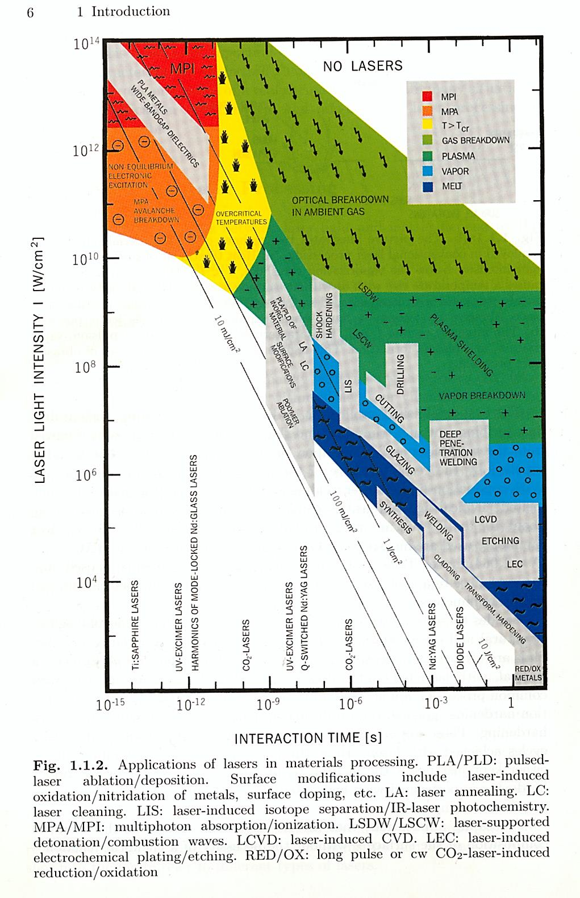
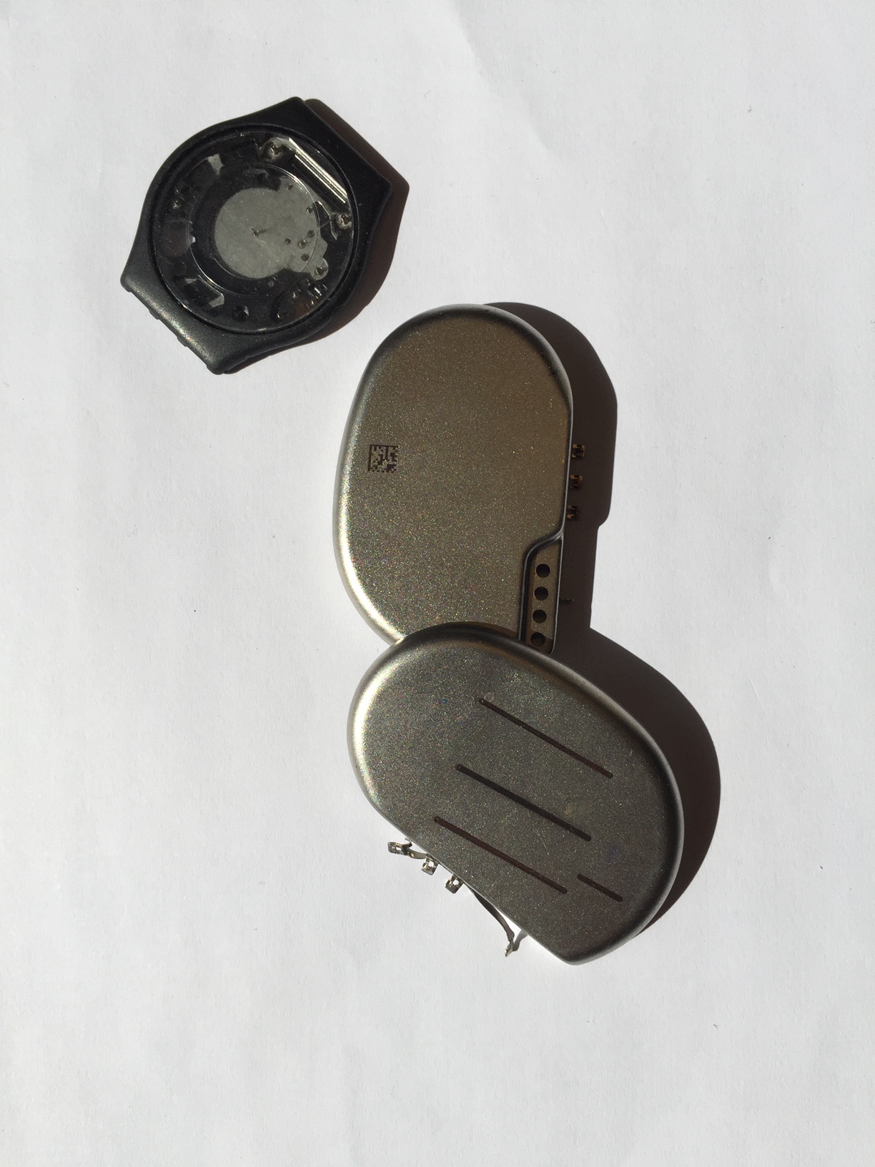
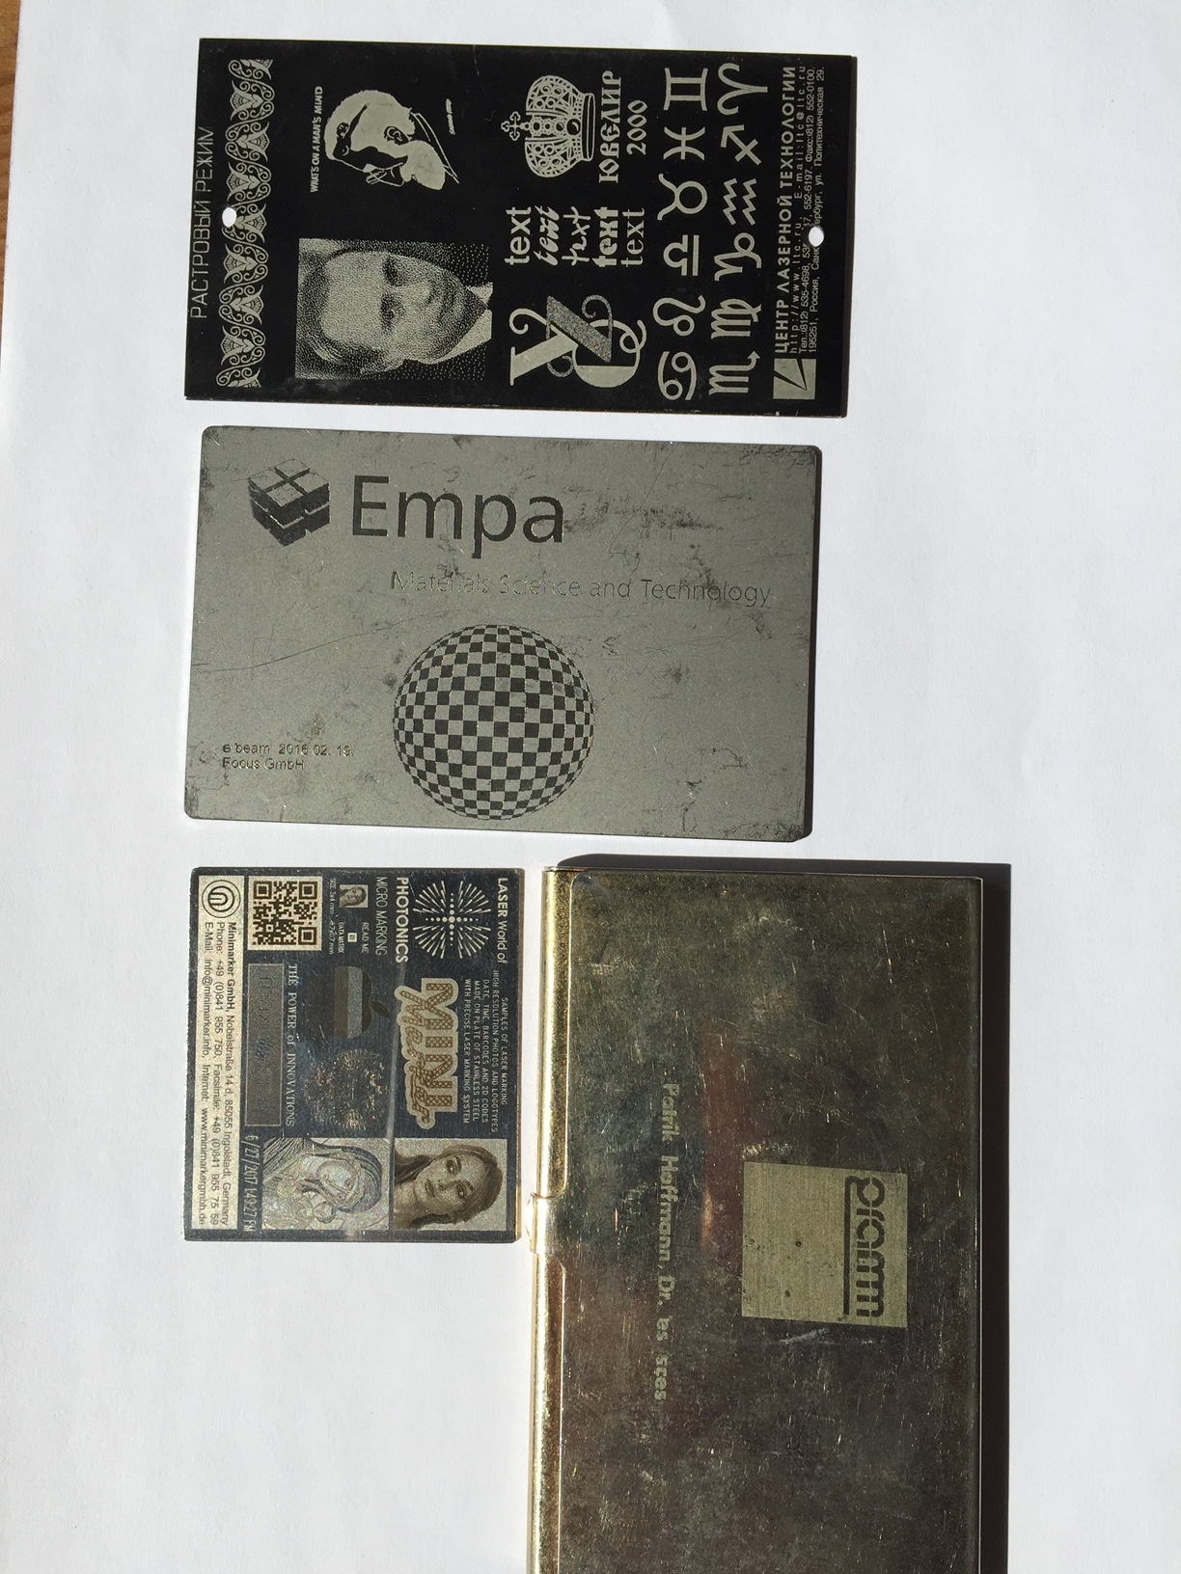
Laser Polymer welding
Laser Oxidation
of soot

Slide 3
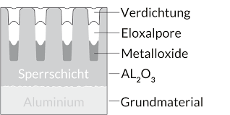
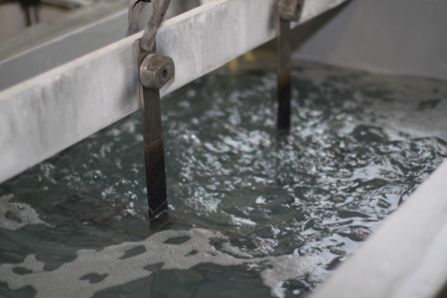
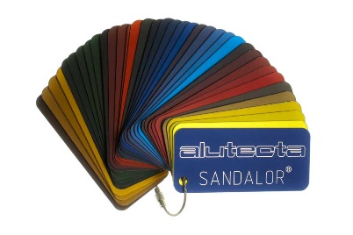
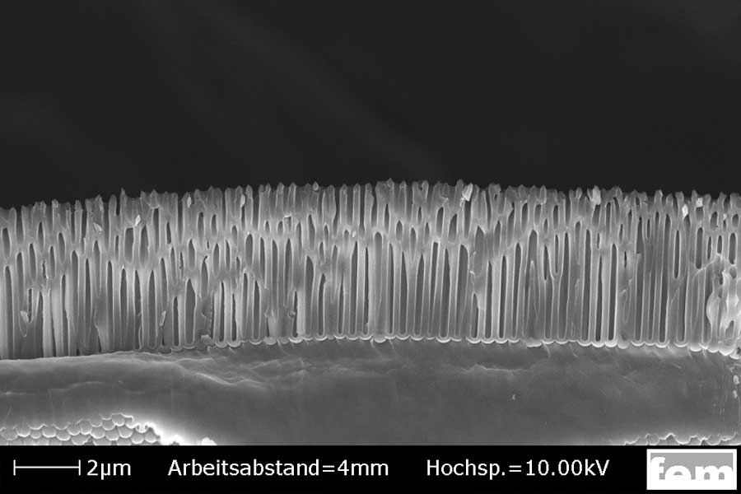
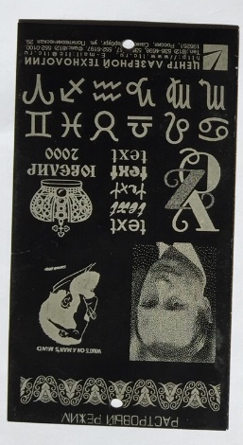
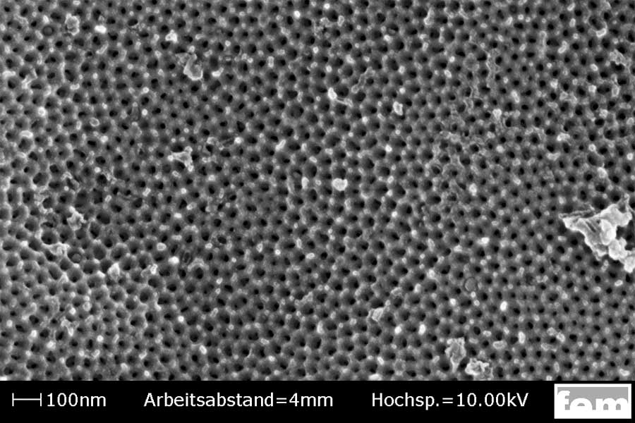
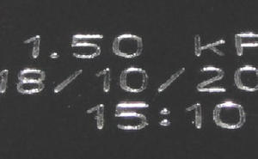
Oxidation of soot in black anodised aluminium
Electrochemical anodisation of aluminium → Eloxage – increases scratch resistance, , fill pores with any color, keep open or close chemically or by water vapor exposure
Black color: often soot
Apply soot into porous Al₂O₃
Irradiate with laser:
to induce oxidation reaction – grey levels
Higher fluence – layer ablated - metallic
Source: google: black Eloxal
Notes:
for metal you do need more intensity – for plastic less -> one can use lower quality laser -> laser diode
economical reason that it have not worked – Nd:YAG to expensive – even Laser diode is more expensive..

Slide 4
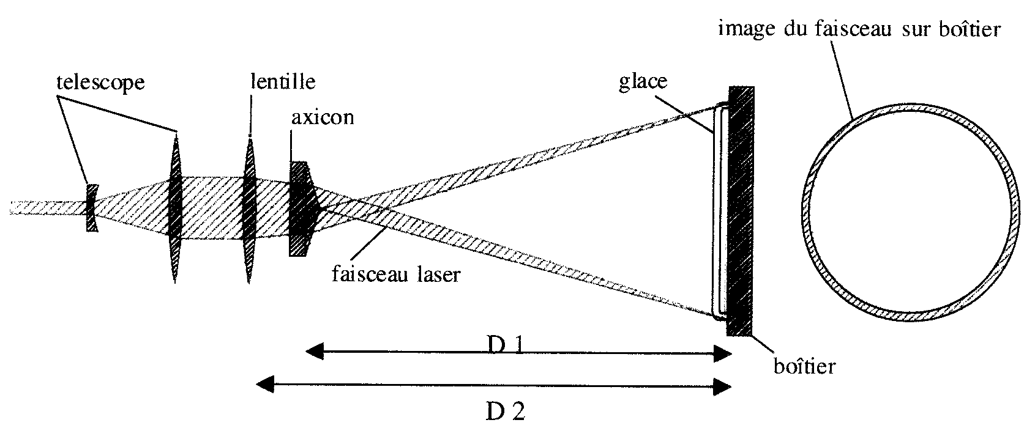
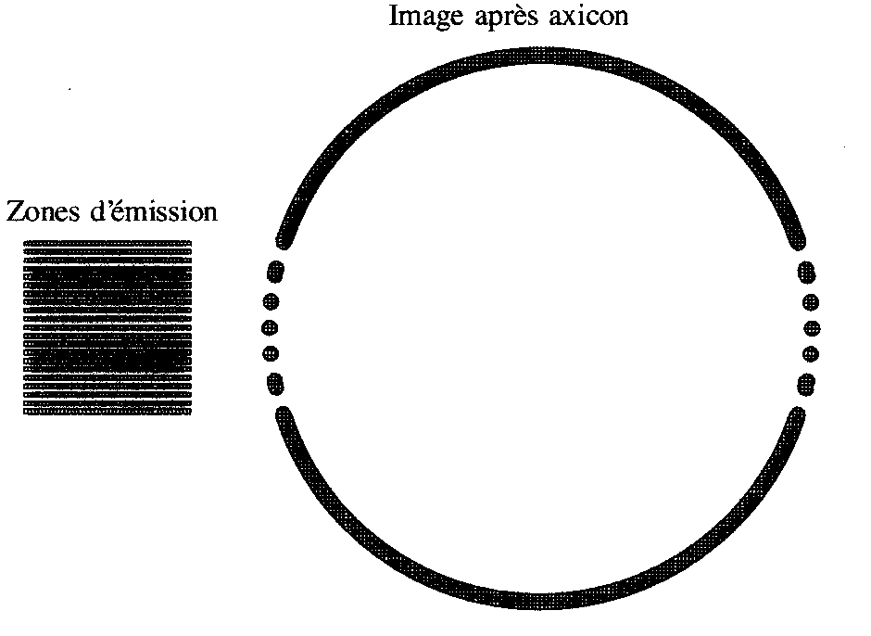
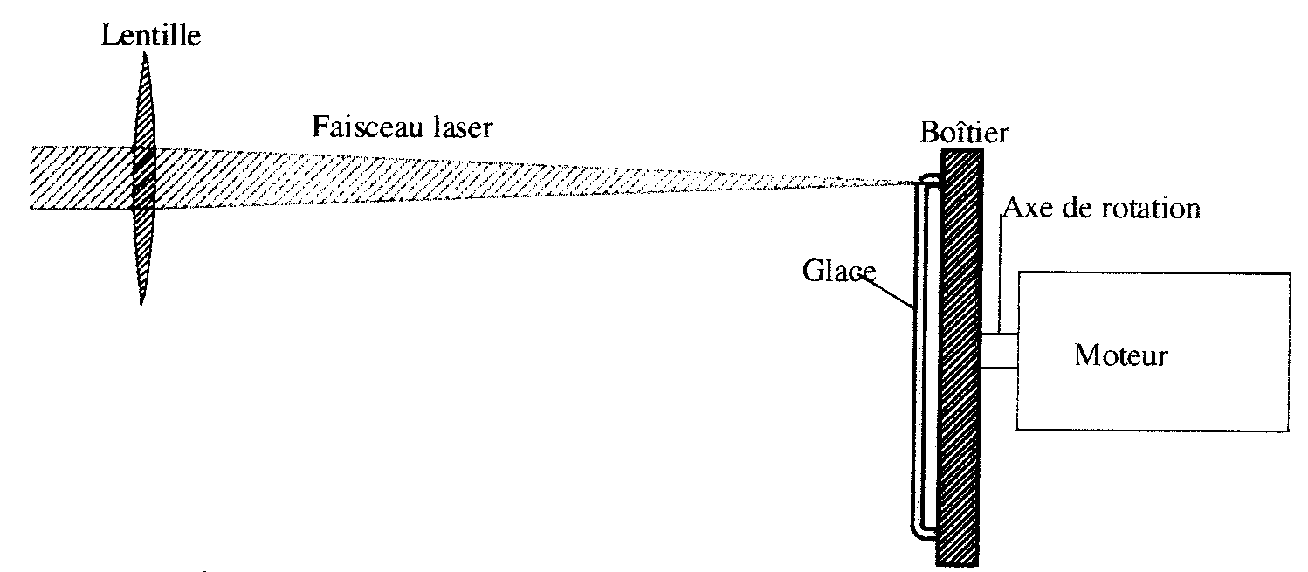
Laser Welding of Plastic
Ring soldering using axicone
Nd:YAG, cw: Rotating watch – no go – thermal story – begin and end visible
Nd:YAG Axicon – good (but expensive)
Laser diode rack – dots in one direction but 2nd exposure after rotation by 90° - good result
End of story – too expensive – better glueing
Ring soldering using rotation of the object
Notes:
for metal you do need more intensity – for plastic less -> one can use lower quality laser -> laser diode
economical reason that it have not worked – Nd:YAG to expensive – even Laser diode is more expensive..

